Slide 1
LUMPS and BUMPS
Dr. Rose Lee

Slide 2
Clinical History
First symptom: how did they first notice lump
Duration: how long has it been present
Progression: has it increased/decreased in size or remained stable since then, does it go away
Multiplicity: previous/other lumps
Associated symptoms: fever, redness, pain, weight change, associated with menstrual cycle
Past history: trauma, surgery, prior malignancy

Slide 3
Clinical Findings
Is palpable or visible to you?
Is it mobile or fixed?
Is it hard or soft?
Look for redness or swelling
Is there drainage or a sinus tract?

Slide 4
Role of Ultrasound
Confirm presence of a mass
Location of mass
Characterize mass
Cyst vs solid
Vascularity
Dynamic information – compression
However, majority of soft tissue masses have nonspecific appearance: DDx driven by location

Slide 5
Scanning Protocol
Use a high frequency linear transducer first
May need to change to lower frequency probe if patient is large or mass extends into deep soft tissues or curvilinear
If the mass is small, trap mass between two fingers to hold down while scanning
Start scanning the nearby, NORMAL, uninvolved area to appreciate normal anatomy (can scan contralateral side too)

Slide 6
Scanning Protocol
First image mass to show relationship with respect to soft tissue layer
Large FOV
Scan along the border of the mass
Then image to show mass close up in detail to assess edges, internal characteristics, and vascularity (may need standoff pad or lots of gel)
Take at least 3-5 images in sagittal and axial through the mass or more if large

Slide 7
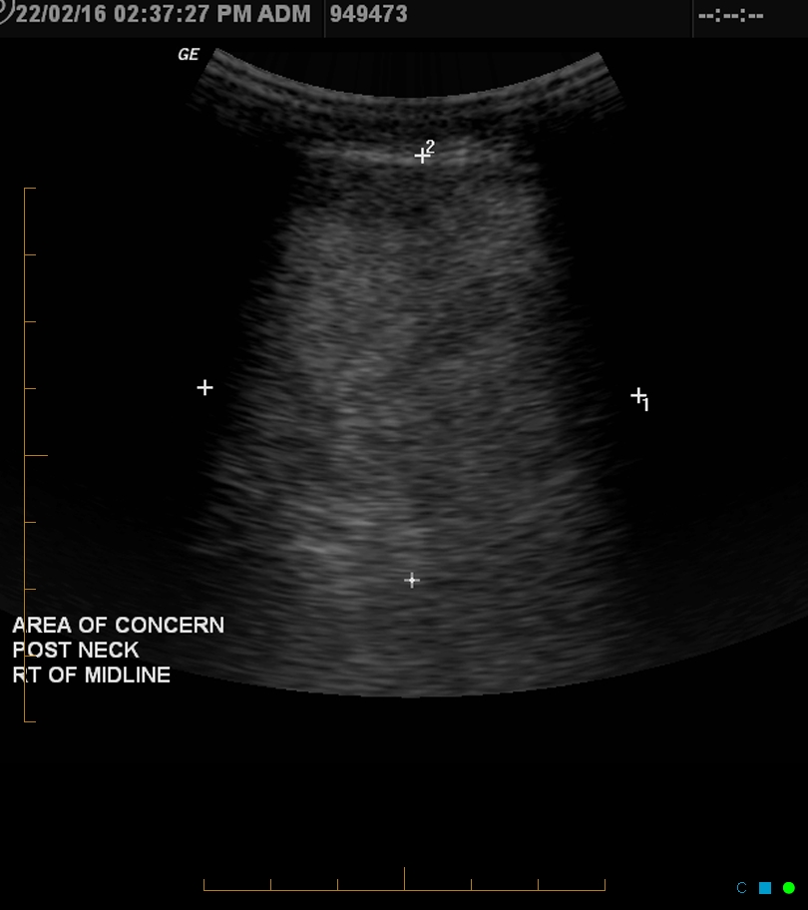

Slide 8
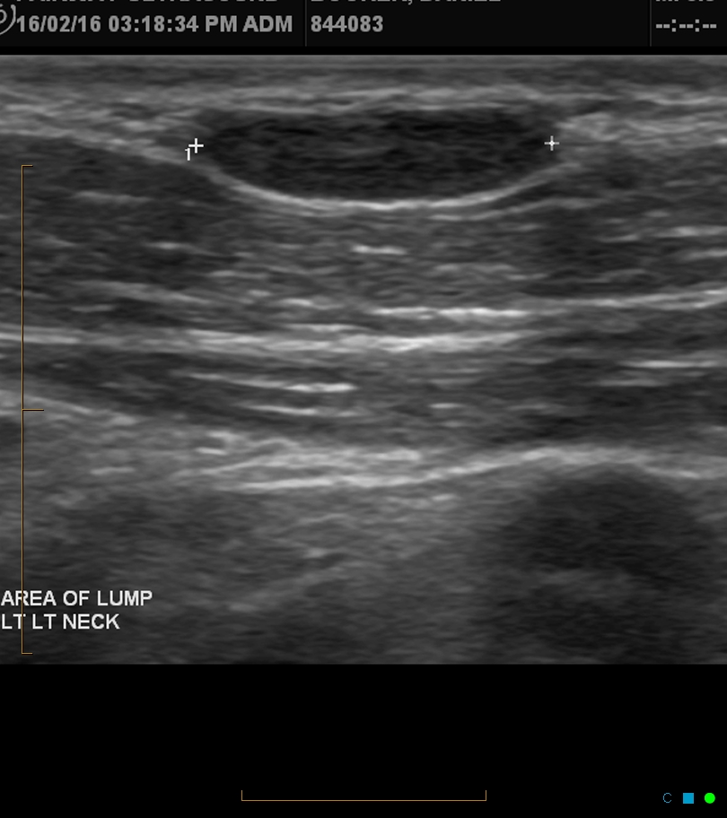

Slide 9
Location Location Location
Body location:
Draw an image
Describe with respect to external landmarks
Soft tissue layer:
Dermal: thin hyperechoic layer
Subcutaneous: hypoechoic fat interspersed with hyperechoic linear (connective tissue septa)
Fascial: thin hyperechoic layer
Muscle: hypoechoic cylindrical structures, with hyperechoic connective tissue, surrounding them
Bone: strong hyperechoic shadow

Slide 10
Normal Soft Tissues

Slide 11
Muscle layer longitudinal
Notes:
Muscles longitudinal

Slide 12
Muscle layer transverse
Notes:
Muscles transverse

Slide 13
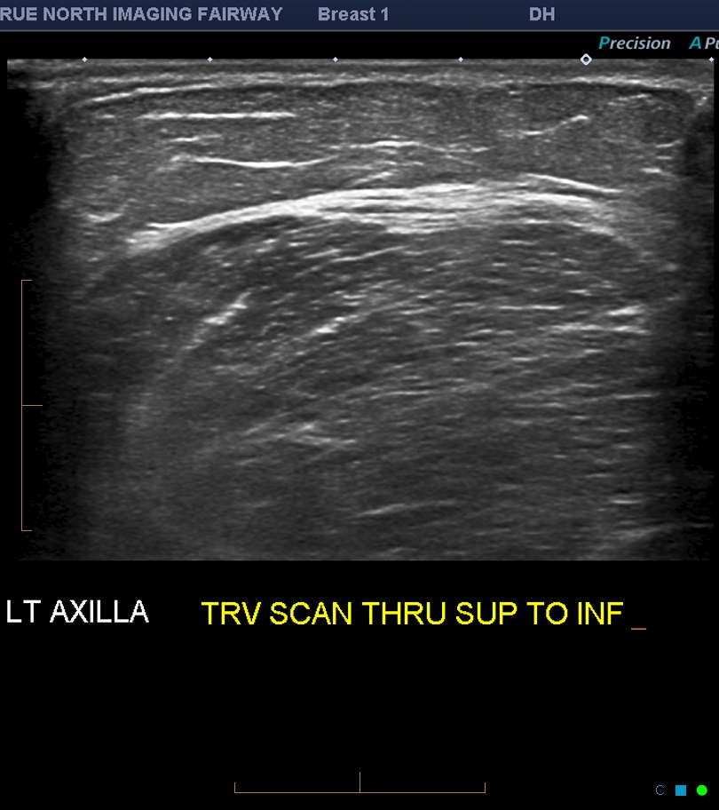
Normal Soft Tissues – axilla

Slide 14
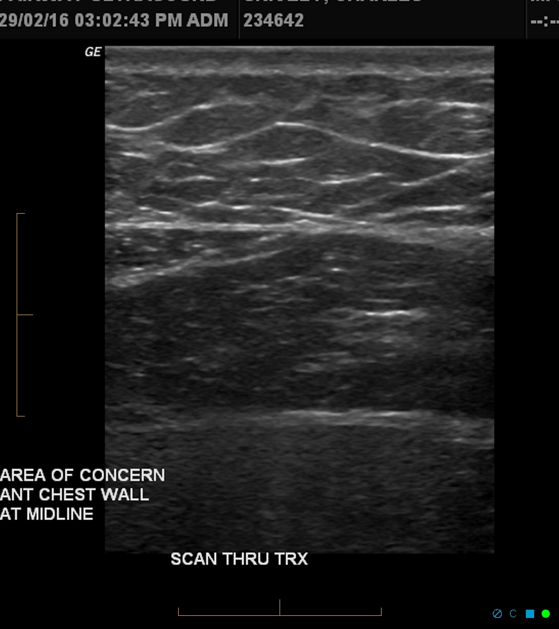
Normal Soft Tissues-chest wall
Notes:
Chest wall

Slide 15
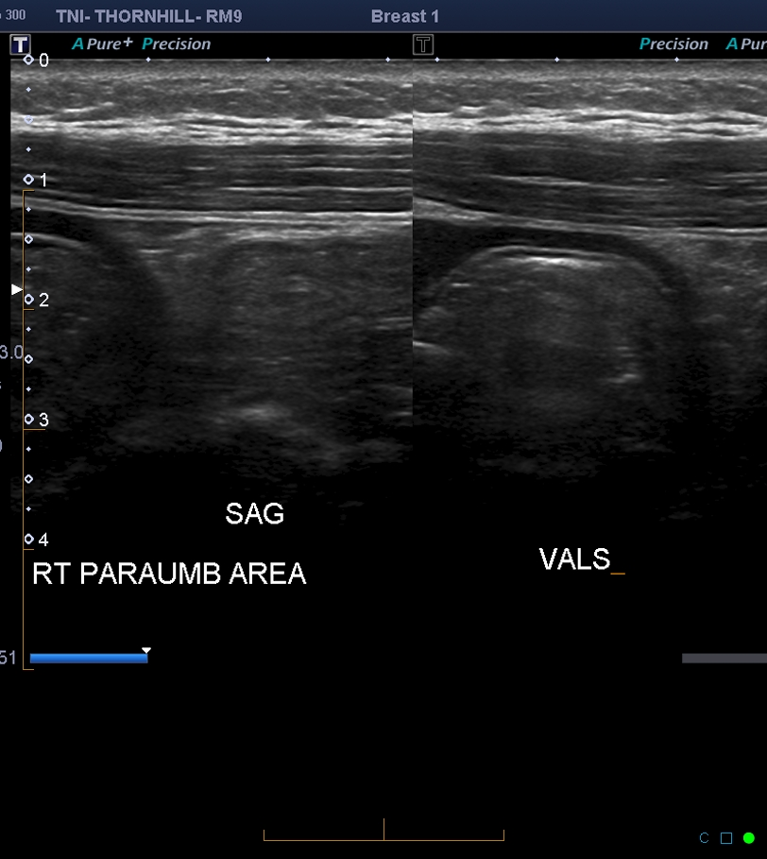
Normal Soft Tissues-abdomen
Notes:
abdomen

Slide 16
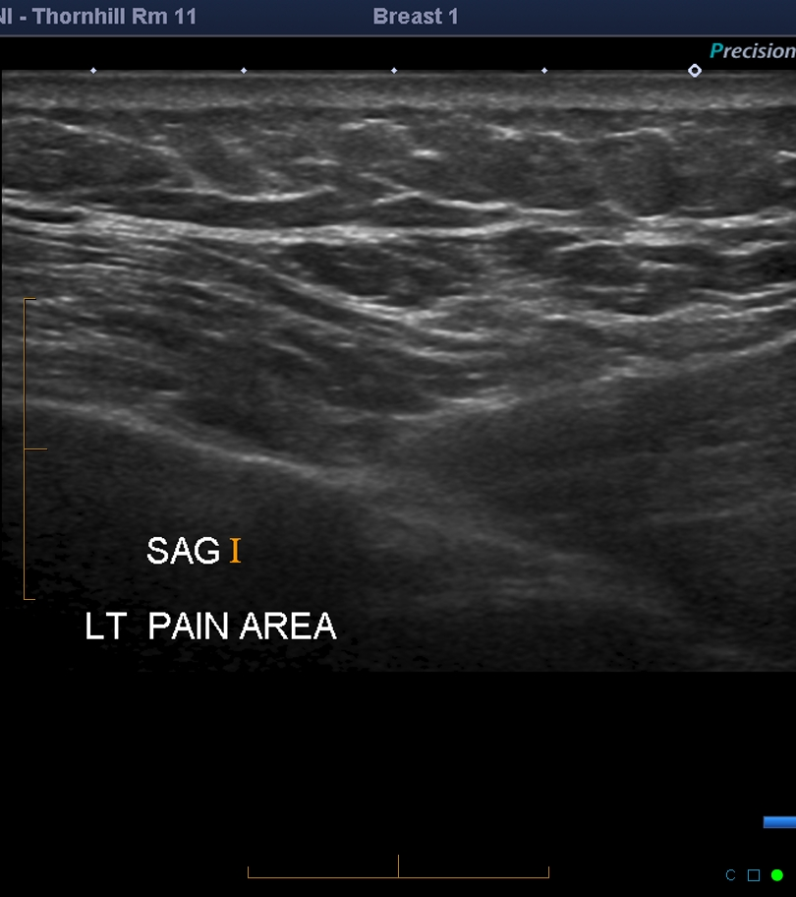
Normal Soft Tissues-flank
Notes:
Left flank

Slide 17
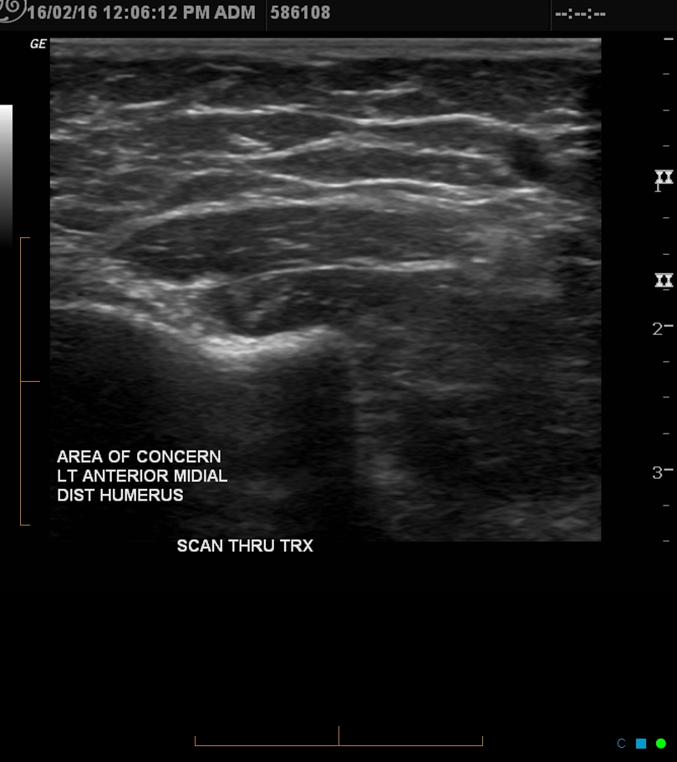
Normal Soft Tissues-arm
Notes:
Upper arm

Slide 18
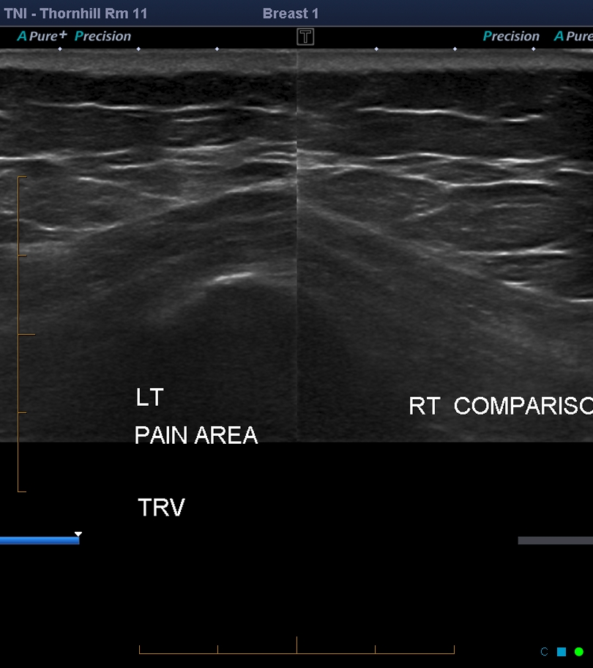

Slide 19
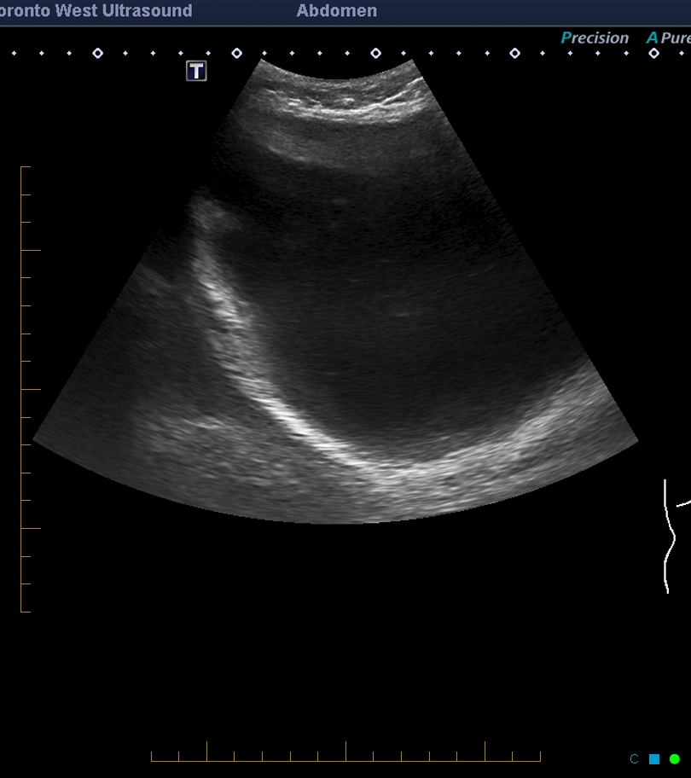
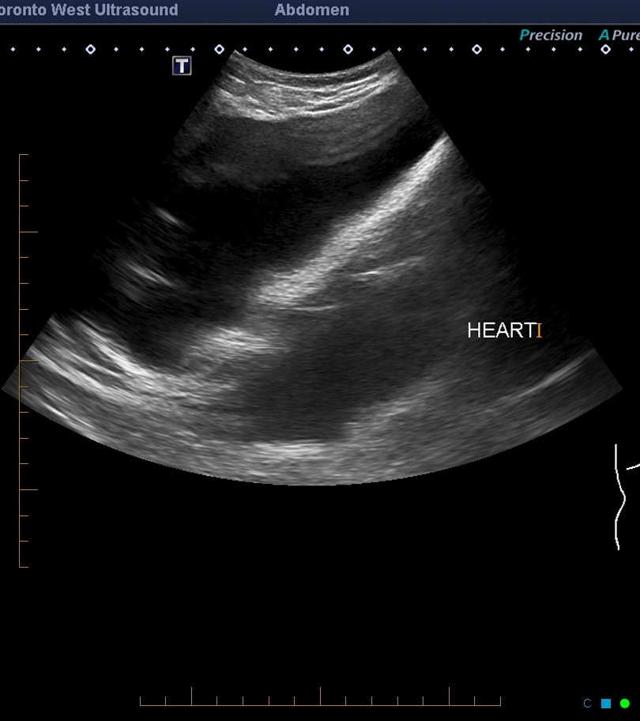
Where is this mass?

Slide 20
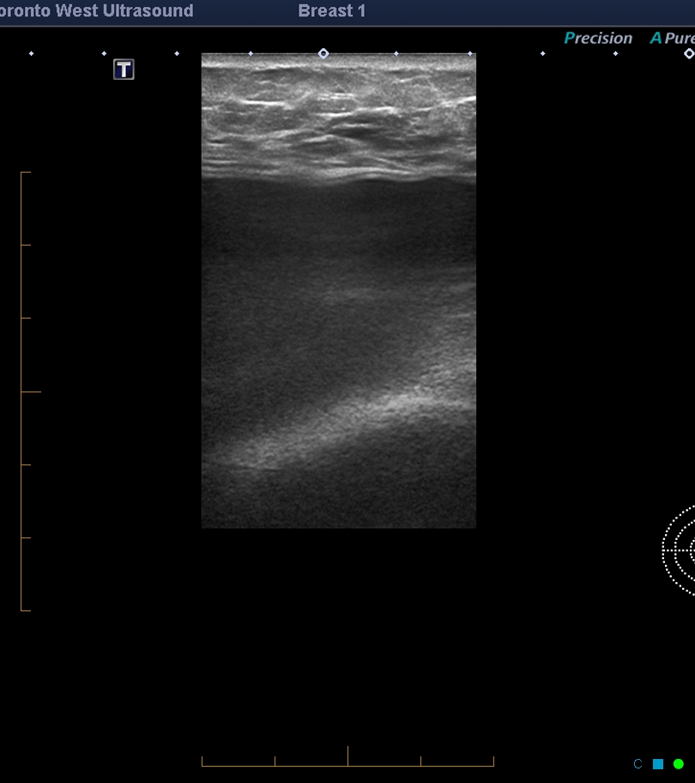
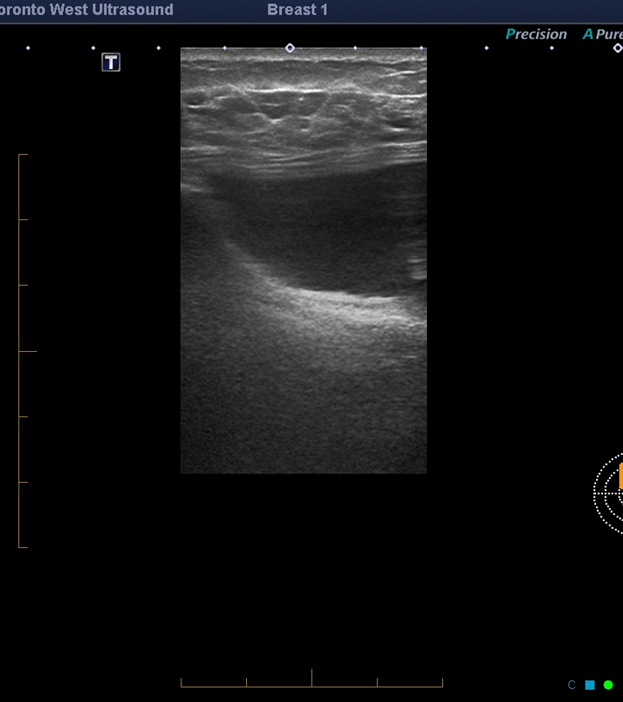
Notes:
Retropectoral implants

Slide 21
Characterize Mass
After determination of location
Assess
Shape and margins (image the edges)
Echogenicity
Internal characteristics
Through transmission
Vascularity
Dynamic: mobility and compression

Slide 22
Vascularity
Important to differentiate solid vs cystic
If present, confirms mass is solid
If absent, mass can be solid or cystic
Must show spectral doppler waveform to prove vascularity

Slide 23
Colour Doppler
Depicts presence and direction of blood flow
Pro:
Overall view of flow in the region
Rapid assessment of flow direction and velocity
Cons:
Limited flow information (esp deep tissue)
Poorer temporal resolution at increased depth

Slide 24
Colour Doppler Artifacts
High colour gain: produces colour noise and obscures the true Doppler signal
Eliminate by setting gain just below the introduction of random colour or speckle
Flash artifact: sudden marked movement of the transducer or the tissue within the field of view
Eliminate by holding transducer still and asking patient to be still ie breath hold
Mirror image artifact: blood vessel is located very close to a large, highly reflective surface such as the lung
Eliminate by changing transducer position or window

Slide 25
Colour Doppler Artifacts
Poor spatial resolution: especially deeper structures
Angle of insonation: vessels-heel toe
Aliasing: abnormally high velocities exceed the rate at which the system can record the velocity correctly
Methods to eliminate: Increase the PRF or velocity scale; Shift the baseline; Increase the angle of approach; Decrease transducer frequency

Slide 26
Colour Doppler Controls
Box size

Slide 27
Colour Doppler Controls
Colour gain: amplifies or decreases the doppler shift signal

Slide 28
Colour Doppler Controls
Colour scale or Pulse Repetition Frequency (PRF): increases or decreases the maximum velocity that can be displayed without aliasing
The PRF can be altered by the operator to prevent aliasing or to detect low blood flow
As a general rule the PRF should be ideally set at approximately half of the expected velocity of the blood flow in the ROI
The PRF is determined by various controls such as colour box size and velocity range

Slide 29
Colour Doppler Controls

Slide 30
Colour Doppler Controls

Slide 31
Colour Doppler Controls
Persistence or frame averaging
Steering angle

Slide 32
Colour Doppler Tips
To Increase sensitivity
Decrease velocity scale or PRF
Move focal position to the region of interest
Decrease colour box
Increase colour gain
To Decrease flash artifact
Decrease colour gain
Decrease the depth of field of view
Decrease sector size
Use Zoom function

Slide 33
Power Doppler Imaging
Increased sensitivity to low velocity flow
No direction of flow information
No velocity information
Use on all masses if cannot obtain flow on colour doppler
Decrease 2D gain to increase sensitivity
Sometimes flow can be eliminated with too much transducer probe pressure

Slide 34
Spectral Doppler
If detect flow on either colour/power doppler, must perform spectral trace to confirm vascularity is present: confirms mass is SOLID
Number one error: incorrect colour and velocity scales
all techs must learn how to adjust scale on the US machines

Slide 35
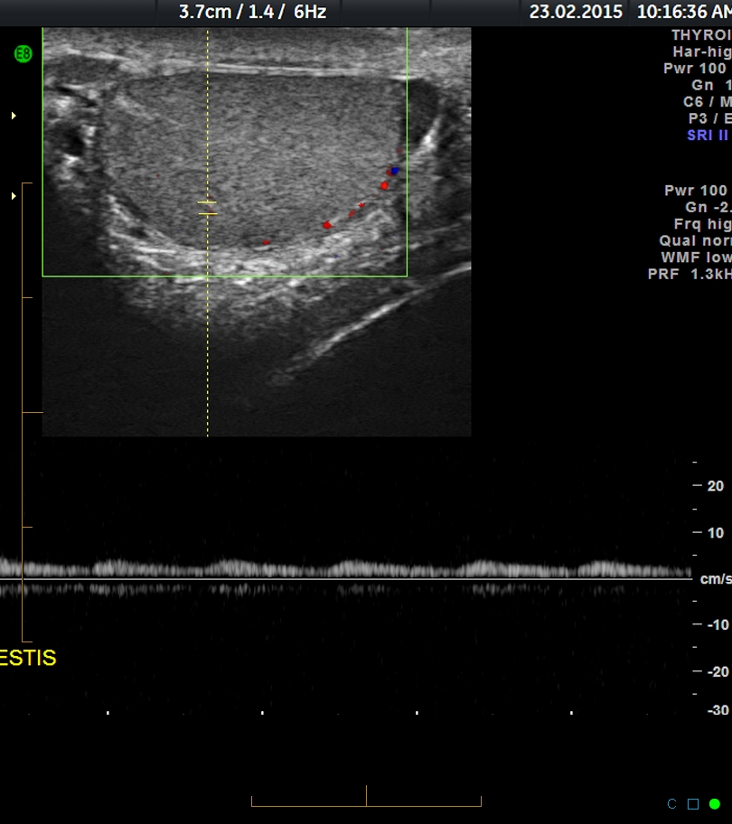

Slide 36
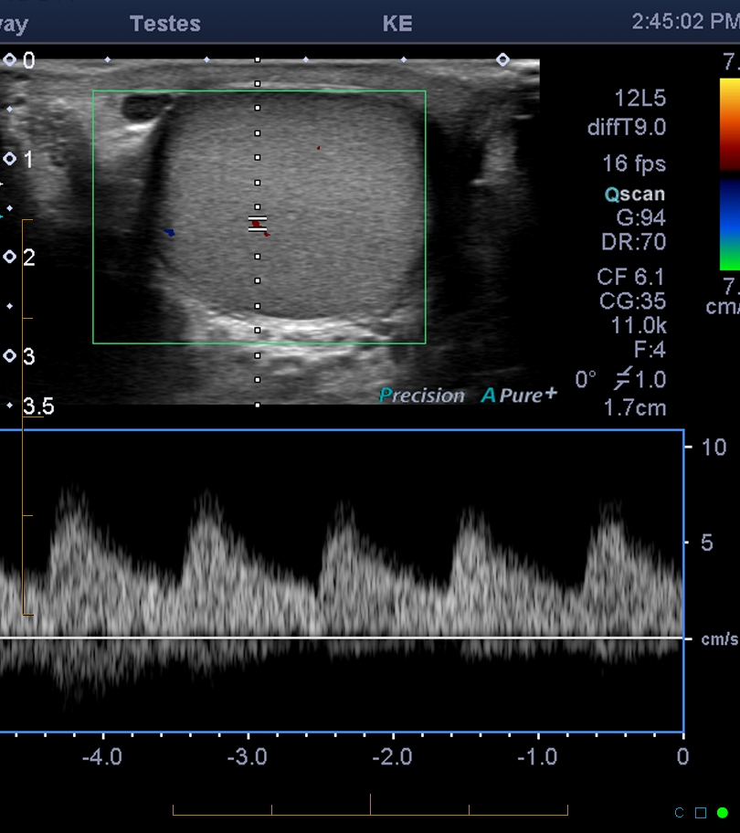

Slide 37
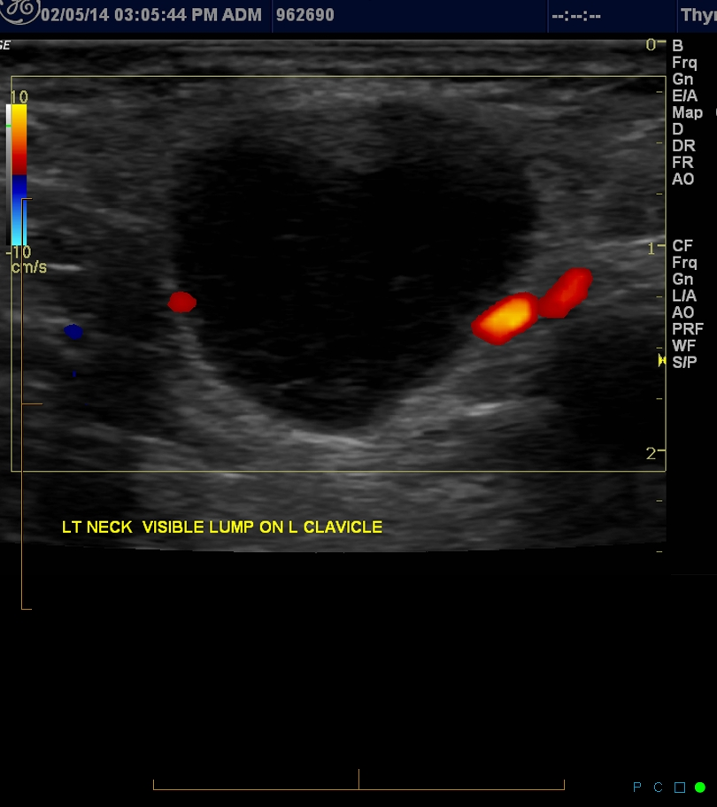
Cystic Mass?

Slide 38
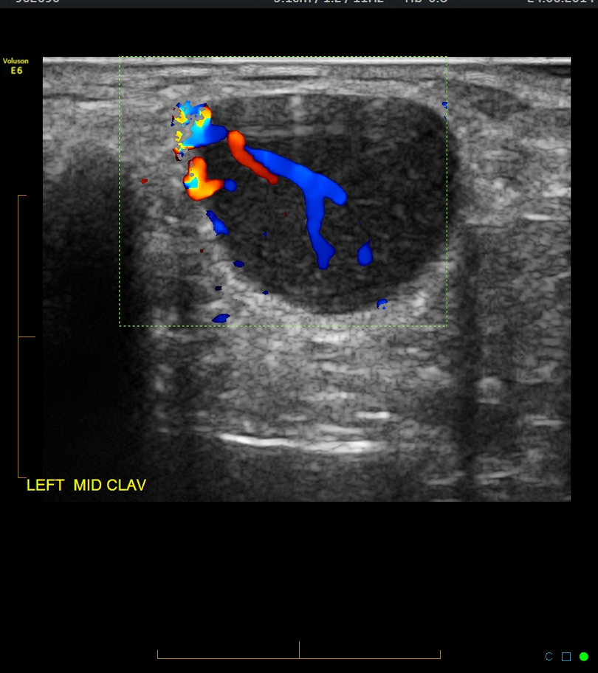
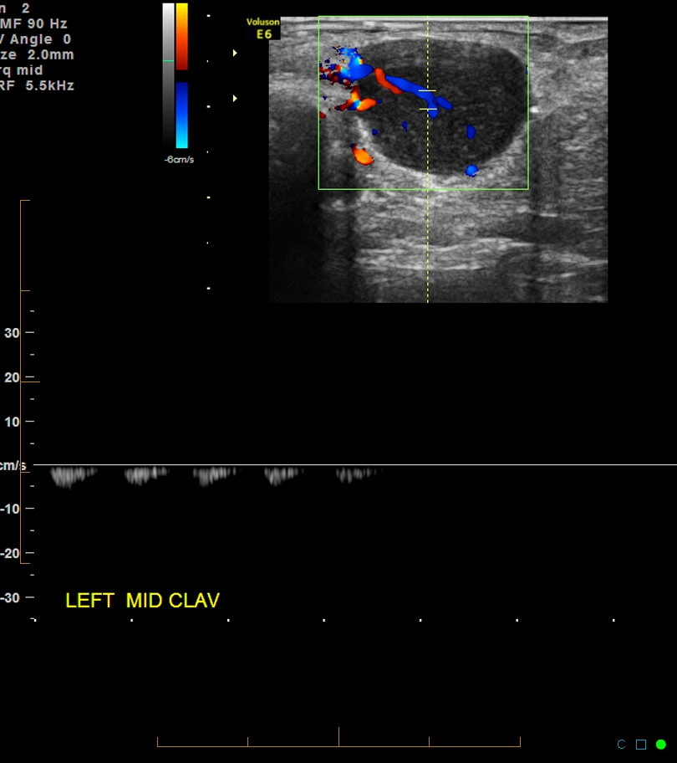
Solid Mass

Slide 39
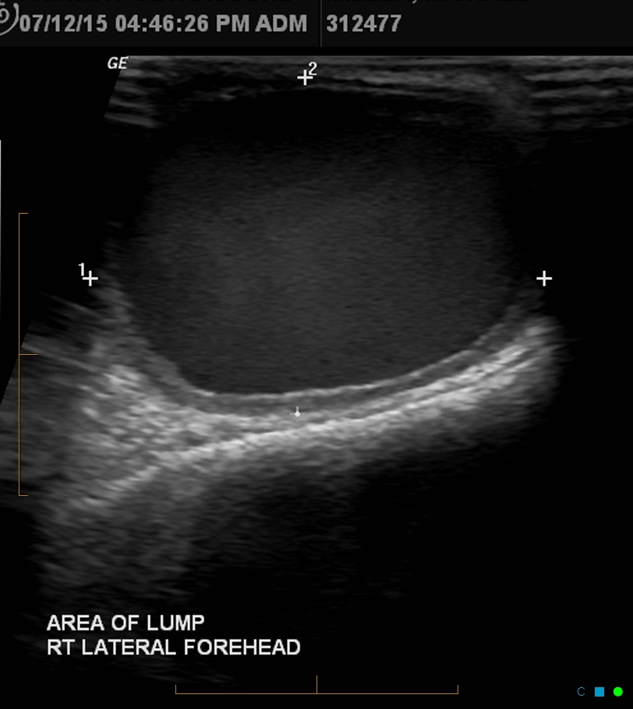
Complex cyst

Slide 40
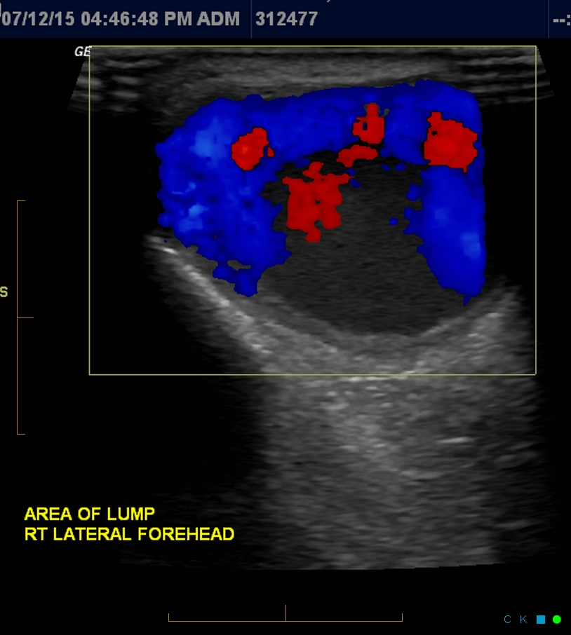
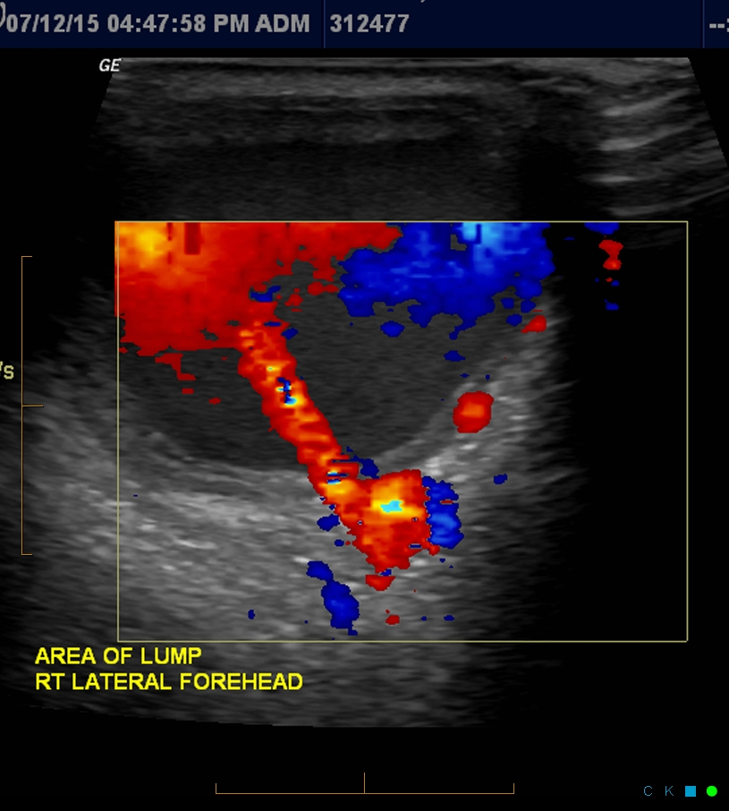
Post-traumatic Pseudoaneurysm

Slide 41
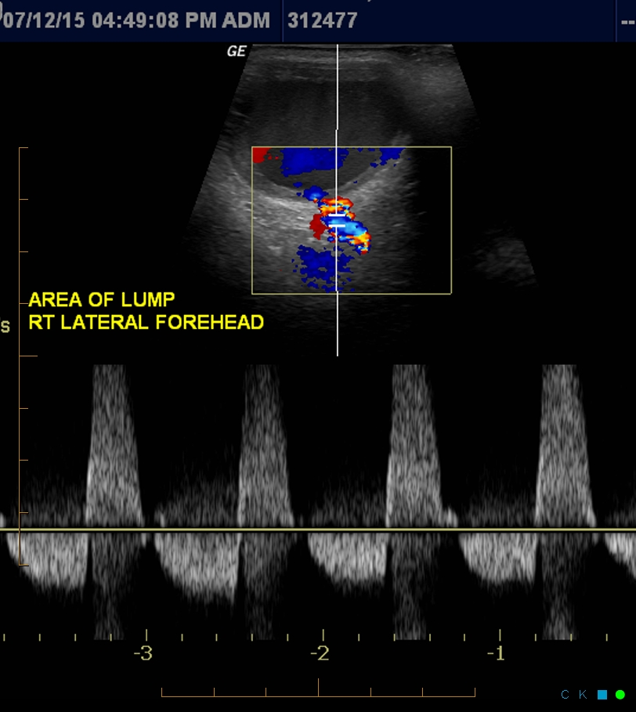
Post-traumatic Pseudoaneurysm
Notes:
Scale to low

Slide 42
Seborrheic keratosis

Slide 43
Cutaneous mets from lung CA

Slide 44
Epidermal inclusion cyst/Sebaceous

Slide 45
Epidermal inclusion cyst/Sebaceous

Slide 46
Epidermal inclusion cyst/Sebaceous

Slide 47
Ganglion cyst

Slide 48
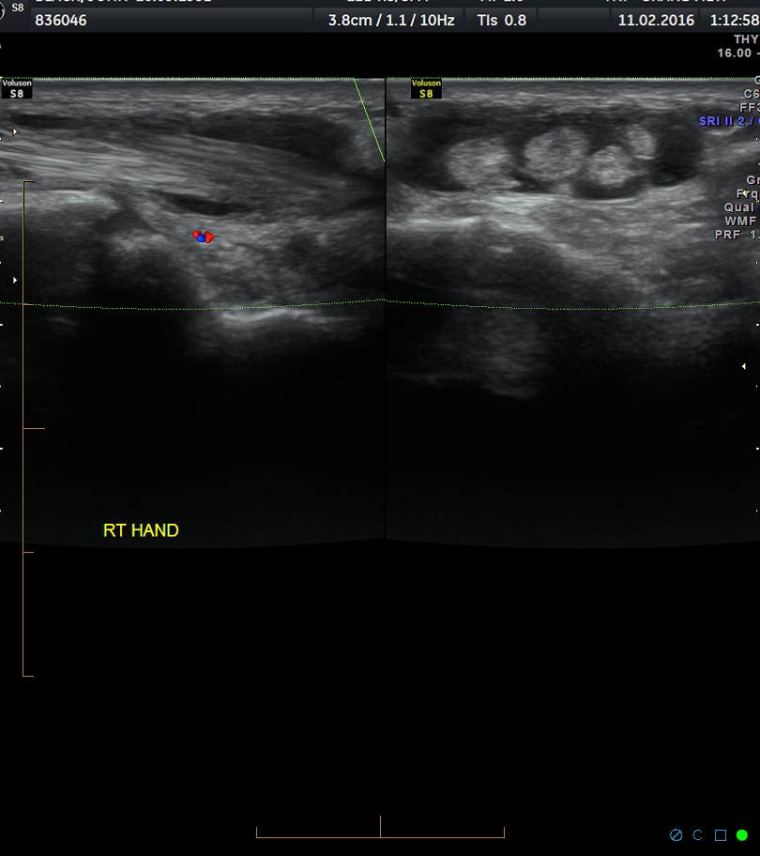
Extensor Digitorum Tenosynovitis

Slide 49
Baker’s cyst

Slide 50
MRI Baker’s cyst

Slide 51
Foreign body

Slide 52
Foreign Body with inflammation

Slide 53
Cellulitis

Slide 54
Phlegmon

Slide 55
Abscess

Slide 56
Abscess

Slide 57
Subcutaneous Hematoma

Slide 58
Fat Necrosis
Notes:
Hyperechoic sucutaneous fat and multiple tiny cysts

Slide 59
Lipomas
Most common soft tissue tumor
Location: subcutaneous most common
Echogenicity: Hyperechoic, Isoechoic, Hypoechoic
Characteristics: smooth borders, wider than tall, wavy internal echogenic lines (otherwise homogeneous), no acoustic shadowing, minimal to no colour doppler,

Slide 60
Subcutaneous Lipoma

Slide 61
Subcutaneous Lipoma

Slide 62
Subcutaneous Lipoma
Notes:
Lipoma peripheral to superficial lobe of parotid gland

Slide 63
Deep Lipomas

Slide 64
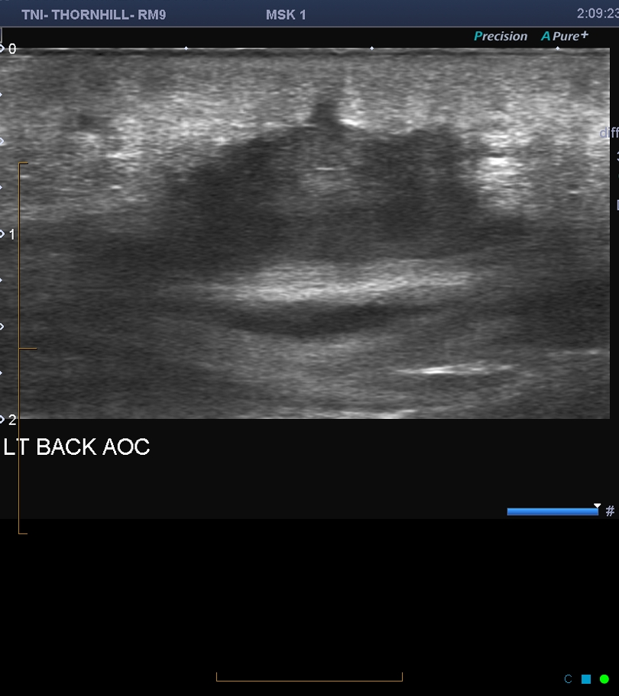
Not a Lipoma

Slide 65
Intramuscular hematomas
If making a diagnosis requires significant trauma +/- anticoagulation
Many sarcoma patients report noticing a mass after trauma
At least follow to exclude a mass, if in doubt biopsy or MRI

Slide 66
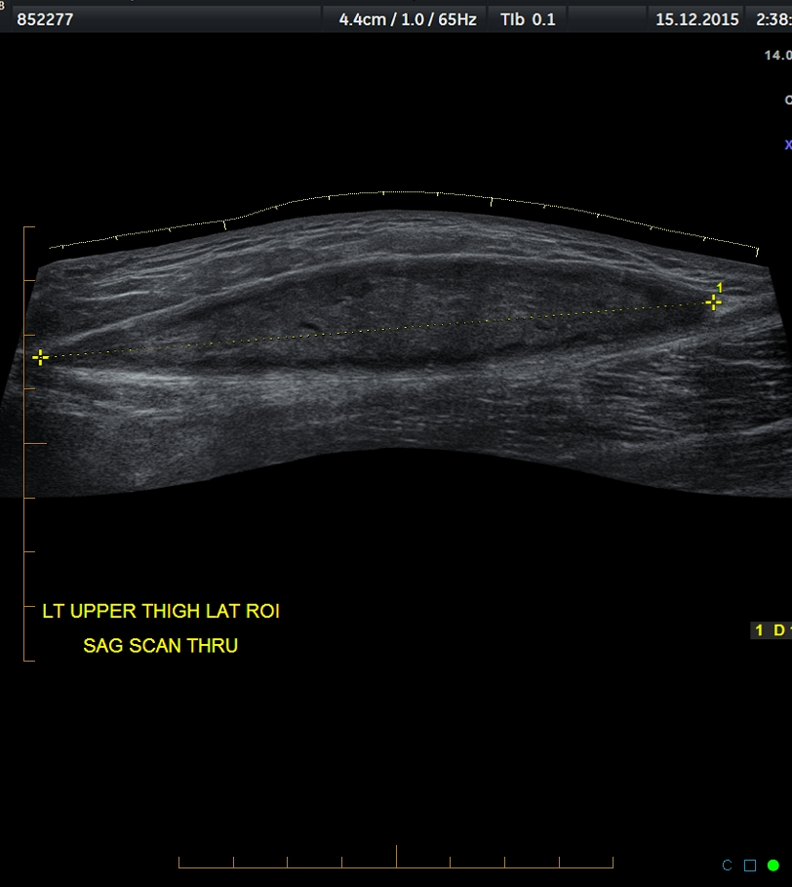
Intramuscular hematoma

Slide 67
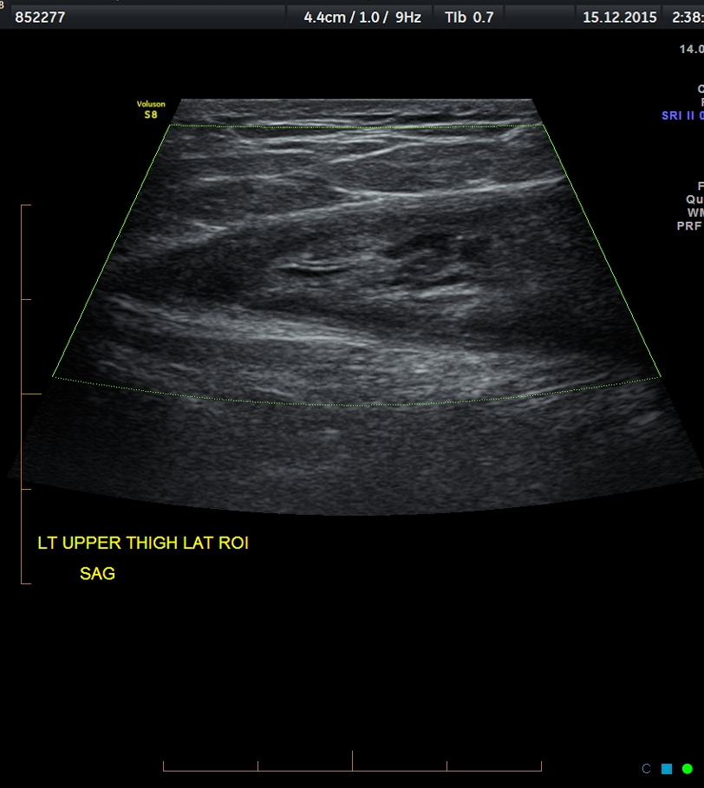
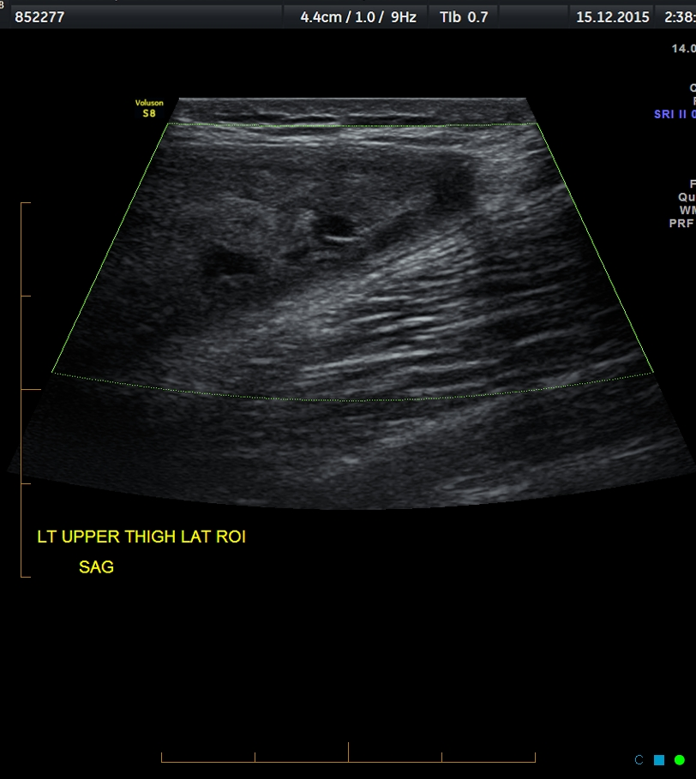
Intramuscular hematoma

Slide 68
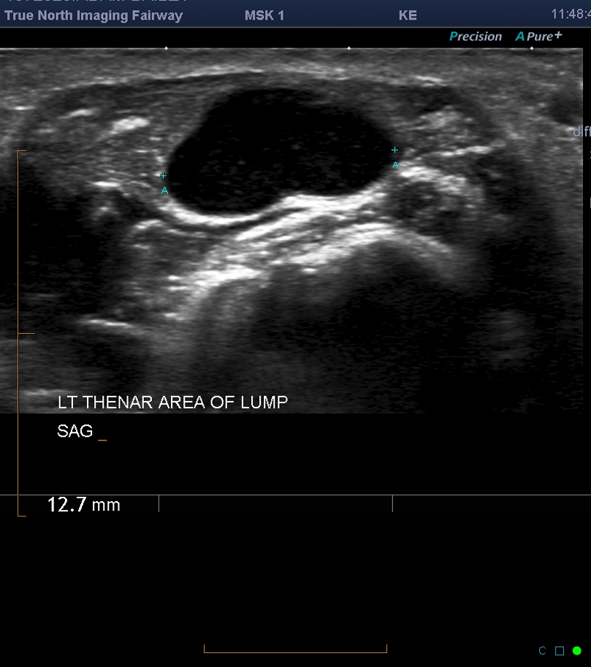
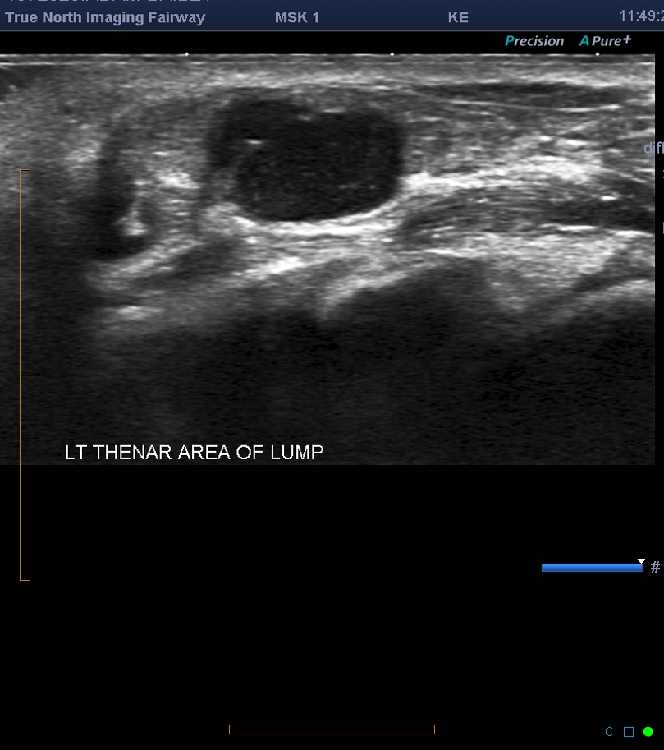
Where is this mass?

Slide 69
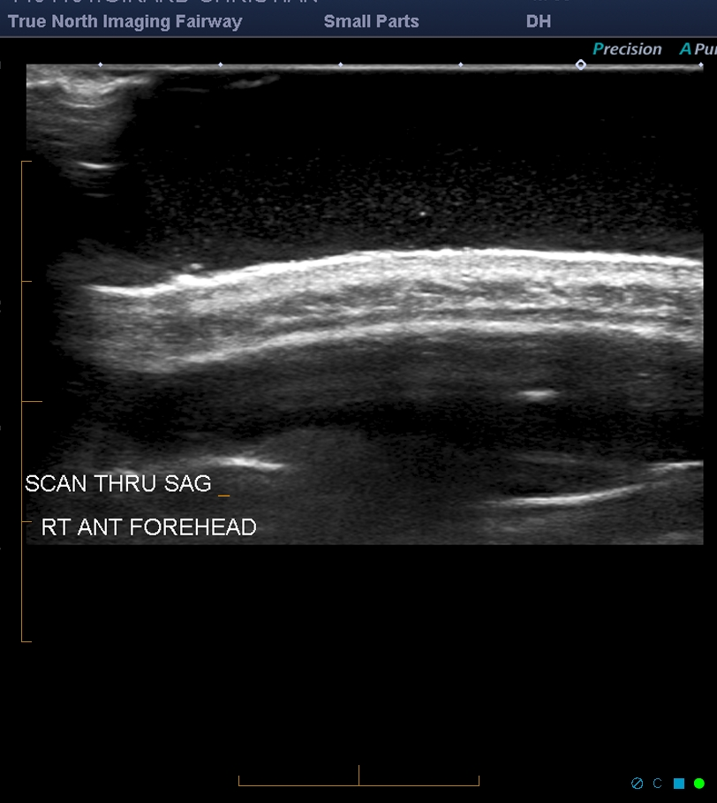
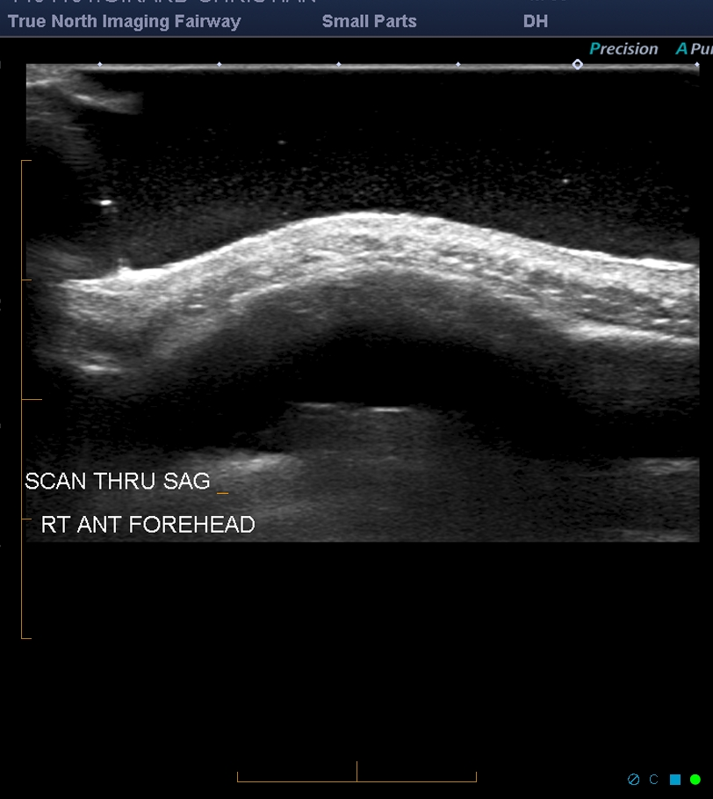
Osseous lesion
Normal adjacent anatomy
mass

Slide 70
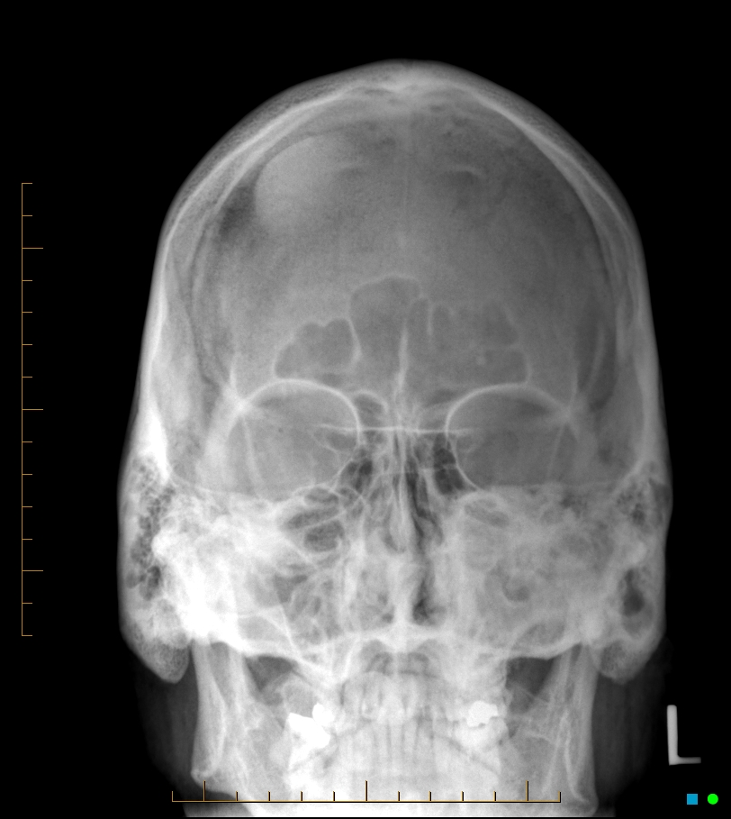
Frontal bone osteoma

Slide 71
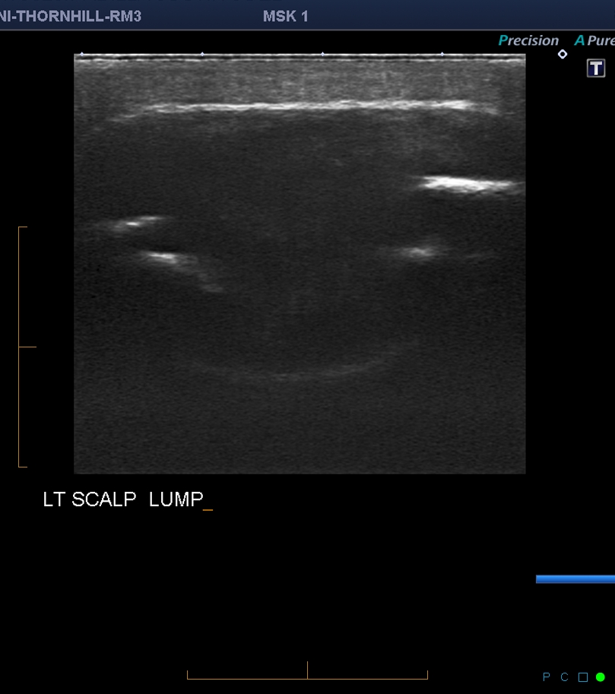
Lesion on head of 11 year old?

Slide 72
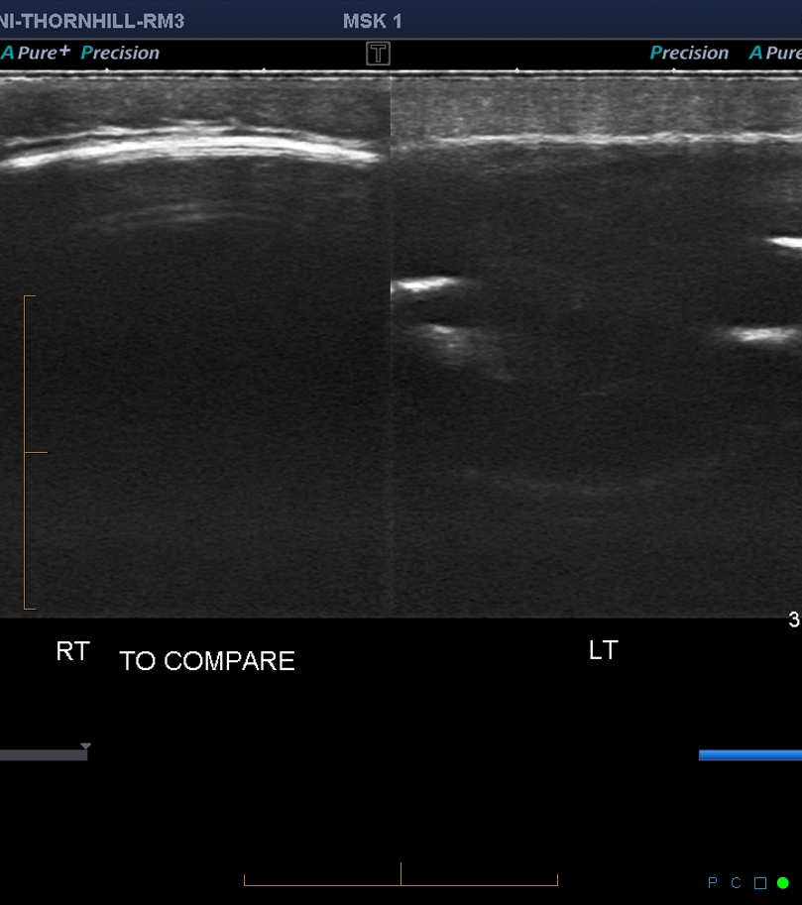
What is the next step?

Slide 73
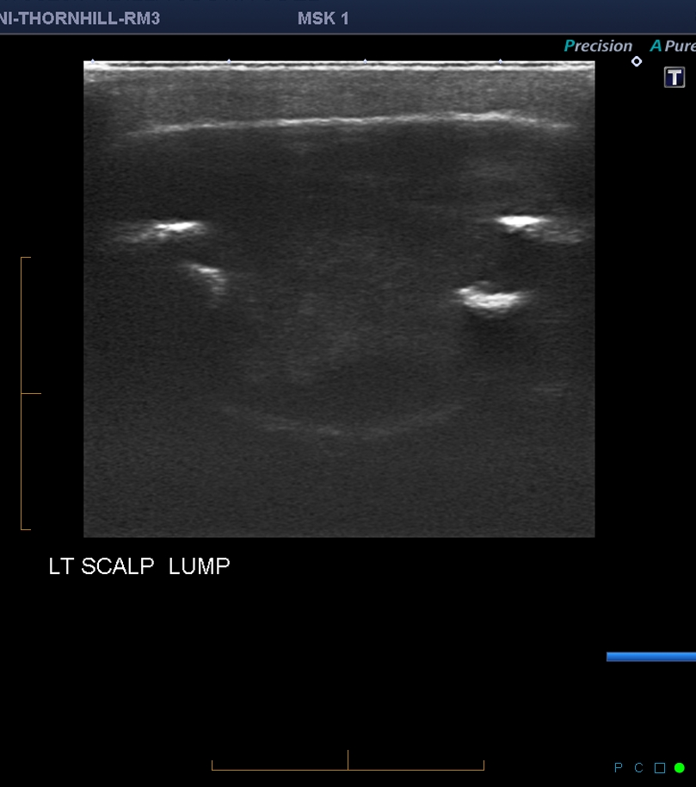
What is it involving?

Slide 74
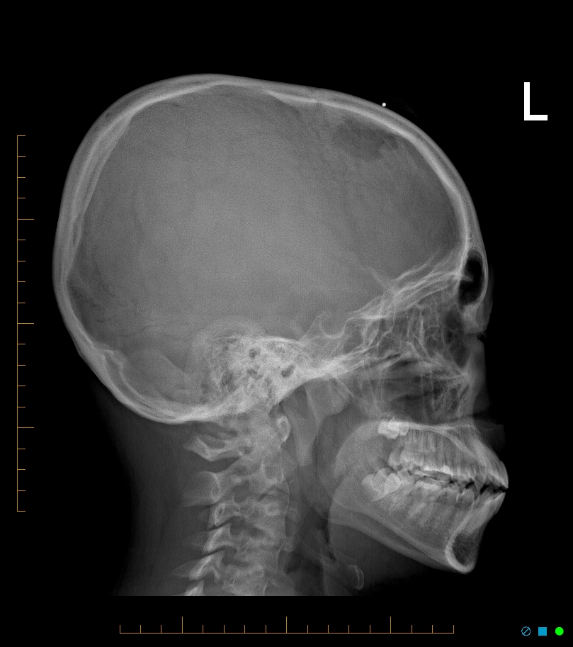
Langerhans Cell Histiocytosis

Slide 75
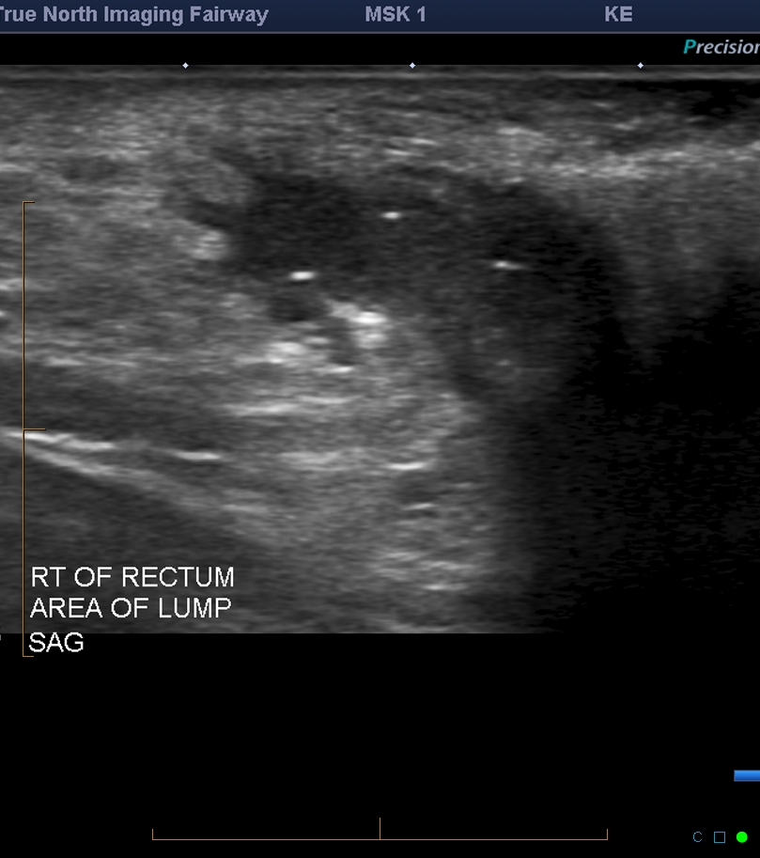
Where is this?

Slide 76
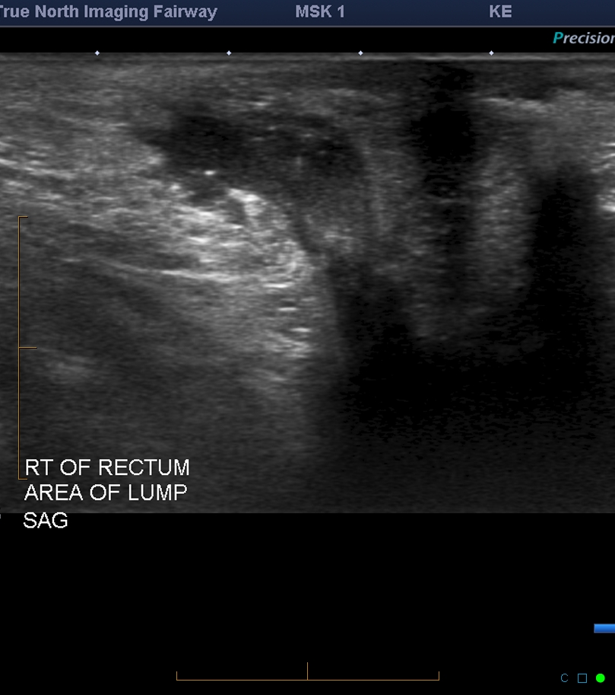
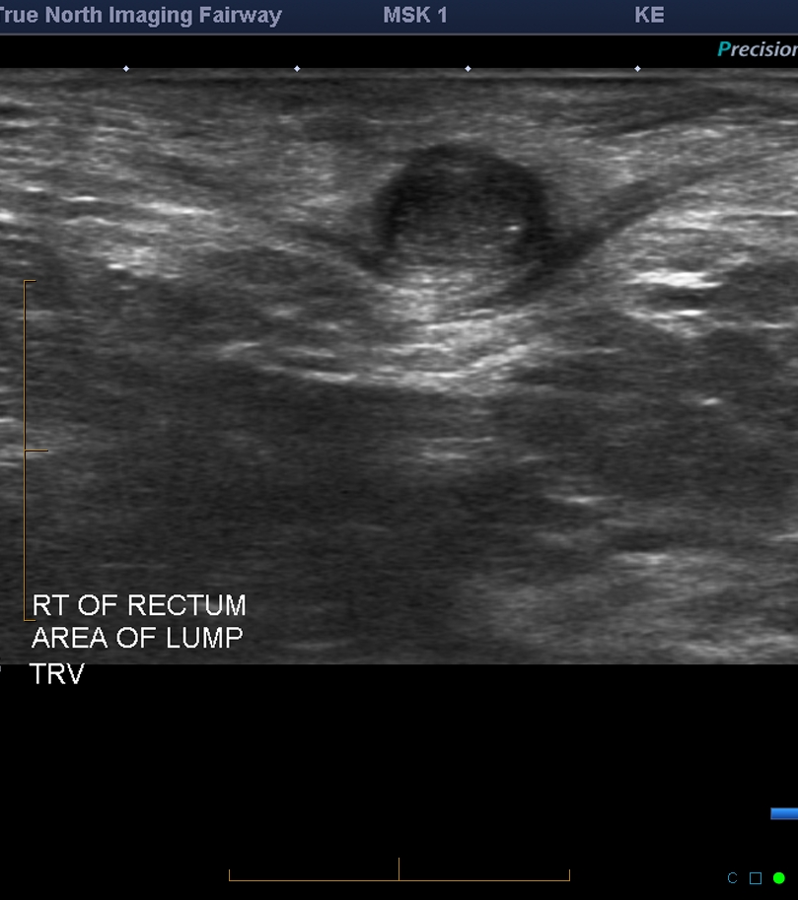

Slide 77
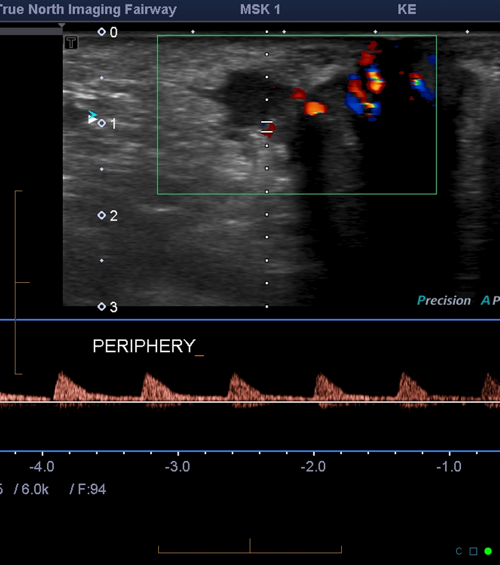
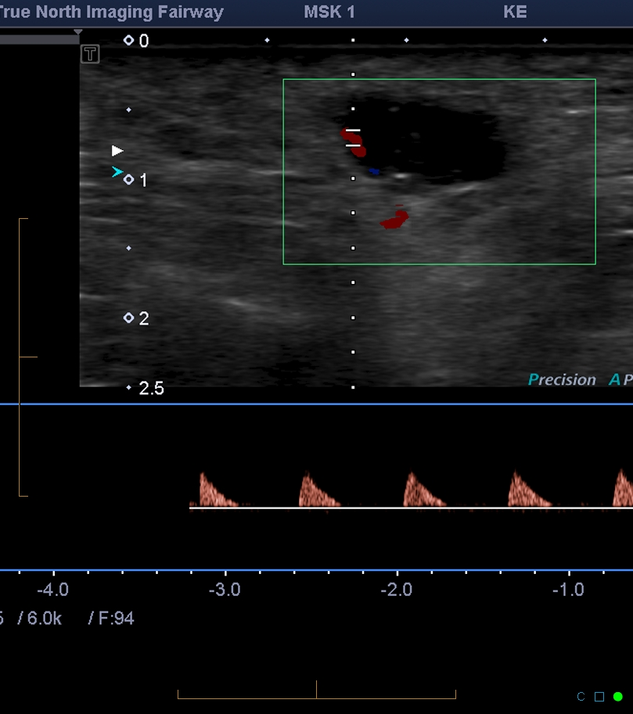
Is there flow within?

Slide 78
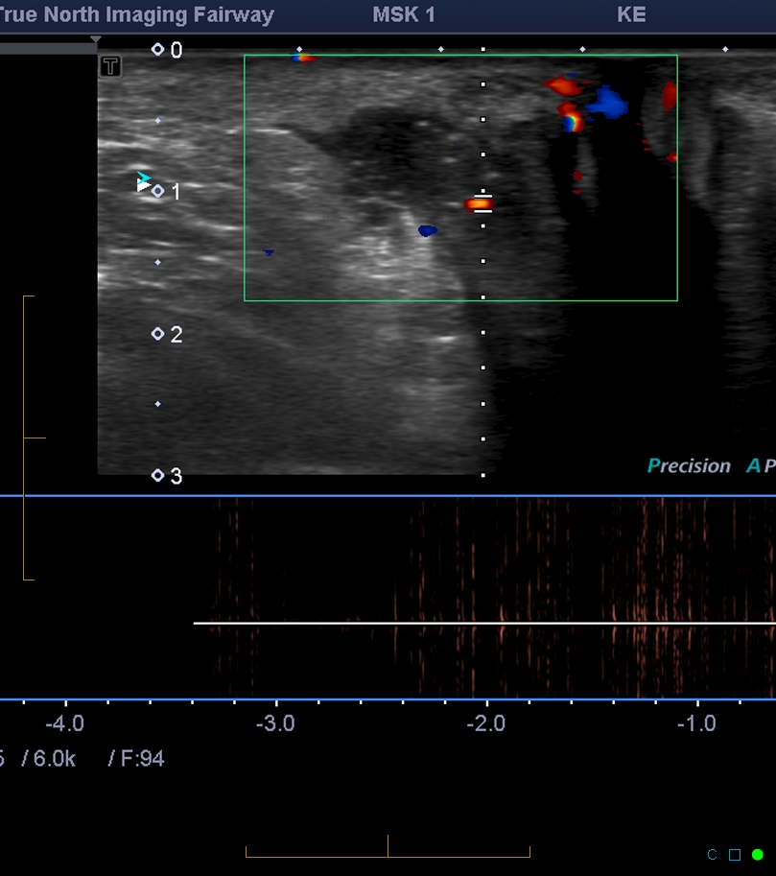
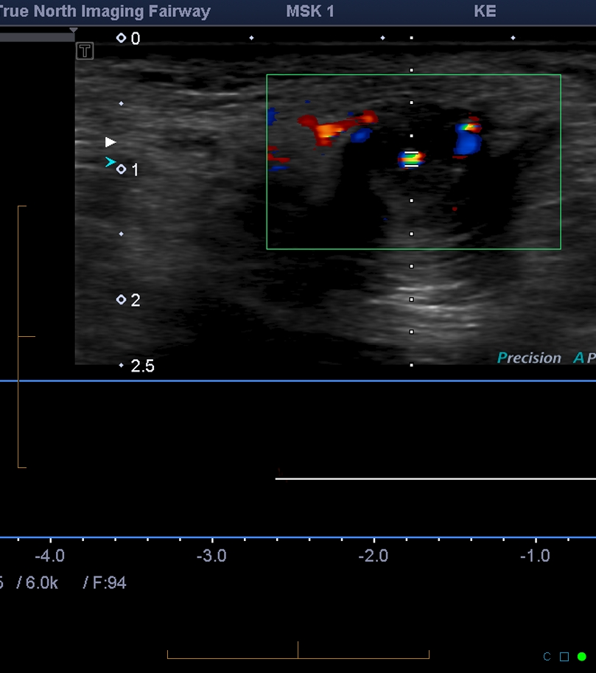
Is there flow within?

Slide 79
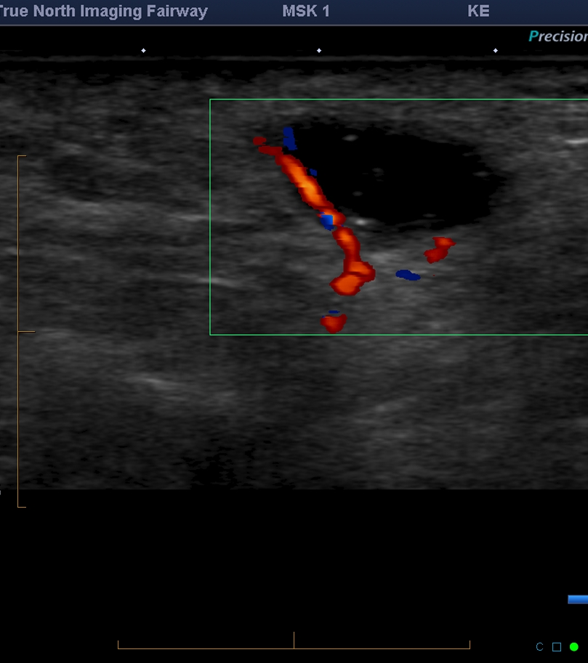
Flow in periphery only

Slide 80
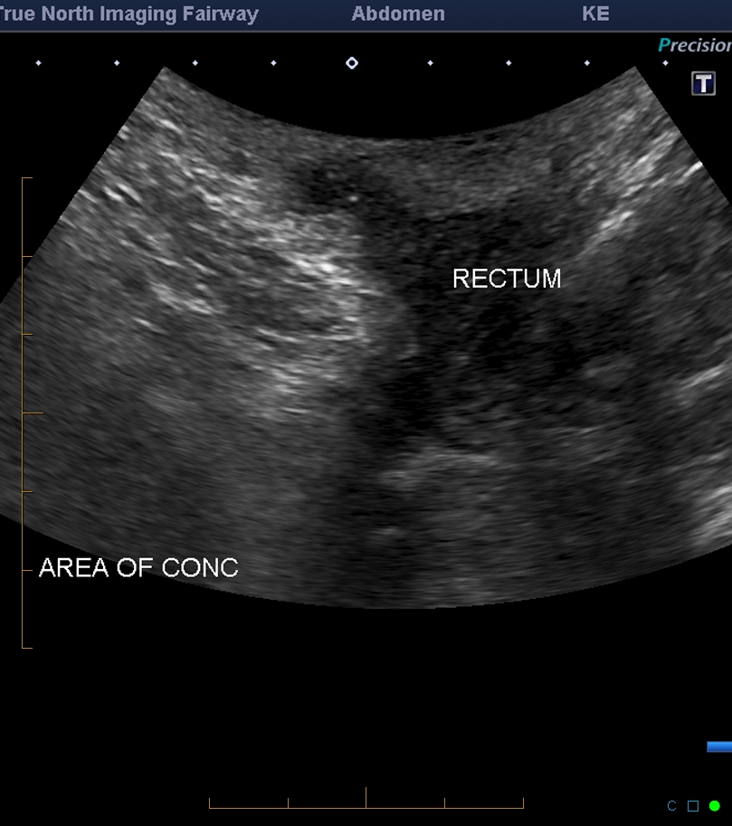
Perianal fistula with abscess

Slide 81
Worrisome Features
Any mass > 5cm or Deep location (deep to fascia)
Painful or enlarging mass
Solid heterogeneous lesion
Tissue distortion
Disorganized flow
Lipomatous mass with internal heterogeneity

Slide 82
Pitfalls
Mass so large, not appreciated
look for edge of mass, start at normal tissue than scan in toward mass
Field of view too small
Start with larger field of view to show layers of soft tissue, show borders
Colour doppler
Make sure small box, drop colour scale/PRF down, velocity scale low, turn up colour gain, use power doppler, prove vascularity with spectral trace

Slide 84
Inguinal hernias

Slide 85
Anterior abdominal wall X-section

Slide 86
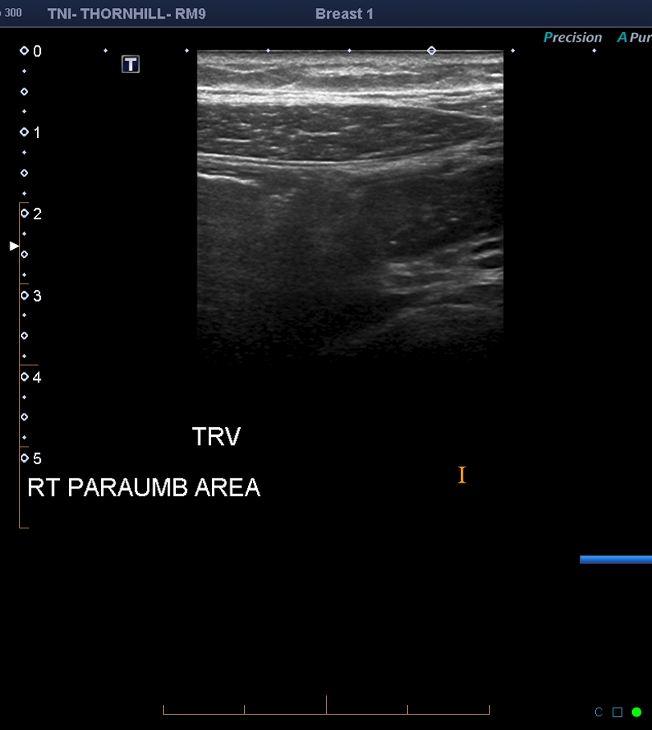

Slide 92
Inferior epigastric artery

Slide 93
Scanning protocol
High frequency linear transducer (10MHz)
Perform at rest and with Valsalva manoeuvers
Scan affected side in both transverse and longitudinal planes (compare with contralateral side if required)
In a standing position, if supine negative
Diagnosis: protrusion of a mass of fat +/- bowel through an abnormal fascial defect

Slide 94
Right inguinal region
external oblique aponeurosis (E), reflected internal oblique aponeurosis (I), and transversus abdominis muscle (T). Conjoint tendon (C) is medial to deep ring through which passes vas deferens and accompanying artery and vein to form spermatic cord (S). Note superficial ring (straight arrow), inguinal ligament (curved arrow), and transversalis fascia and extraperitoneal fat (F). Read More: http://www.ajronline.org/doi/full/10.2214/AJR.05.1813

Slide 95
From within abdomen
Inferior epigastric artery (solid straight arrow), rectus abdominis muscle (R), and inguinal ligament (curved arrow) define boundaries of Hesselbach's triangle (H), location of direct hernia. Indirect inguinal hernia passes through deep ring (open arrow), which is lateral to inferior epigastric artery and above inguinal ligament. Location of femoral hernia (asterisk) is usually lateral to lacunar ligament (L) and inferior in relation to medial inguinal ligament. Note conjoint tendon (C) and vas deferens (arrowhead). Read More: http://www.ajronline.org/doi/full/10.2214/AJR.05.1813
Notes:
H is hassalback’s triangle for direct hernia
Arrow deep inguinal ring for indirect

Slide 96
Transducer probe positions
transducer position to evaluate for Spigelian hernia (1), indirect inguinal hernia (2), direct inguinal hernia (3), and femoral hernia (4). Note locations of inguinal ligament (curved arrow), rectus abdominis muscle (R), lateral boundary of Hesselbach's triangle (H) defined by inferior epigastric artery (open arrow), and spermatic cord (arrowhead). Read More: http://www.ajronline.org/doi/full/10.2214/AJR.05.1813

Slide 97
Number 1
Transverse scan on rectus abdominal muscle, below the umbilicus
Looking for inferior epigastric vessels, just deep to it
Also location for Spigelian hernias

Slide 98
Rectus Abdominis with IEV

Slide 99
Spigelian Hernia

Slide 100
Right Spigelian Hernia

Slide 101
Move towards Position 2

Slide 102
Number 2
Follow inferior epigastric vessels from position 1 from rectus muscle toward inguinal canal
Keep IEV in center of image
As the probe is moved inferiorly, the IEV pass from medial to lateral and superficial to deep towards their origin at the external iliac vessels
Once, reached inguinal canal, probe is on deep ring of canal
Site of INDIRECT hernias: fascial defect is lateral to IEV
Small hernia neck

Slide 103
Transducer Probe 2 position
E is inferior epigastric vessels
A femoral art
V femoral vein
C spermatic cord
Arrow, superior pubic ramus
Notes:
E is inferior epigastric vessels
A femoral art
V femoral vein
C spermatic cord
Arrow, superior pubic rami's

Slide 104
Inguinal ligament

Slide 105
Deep inguinal ring

Slide 106
Indirect hernia

Slide 107
Move towards position 3

Slide 108
Number 3
Move transducer slightly inferior and medial, but stay above the pubic tubercle
Site of DIRECT hernias: fascial defect is medial to IEV
Large hernia neck

Slide 109
Direct hernia

Slide 110
Move towards position 4

Slide 111
Number 4
Move below inguinal ligament
Femoral artery and vein are in a transverse plane
Saphenous-femoral junction: landmark for inferior aspect of femoral canal (no hernia below this)
Move probe above saphenous-femoral junction
Hernia seen coming from above but medial to femoral vein

Slide 112
Greater saphenous vein

Slide 113
Greater saphenous vein landmark

Slide 114
Femoral Hernia
Notes:
At rest and with Valsalva

Slide 115
Femoral Hernia

Slide 116
Schematic review
Black oval deep inguinal ring
B DIRECT-hernia is medial to IEV
C INDIRECT- hernia is lateral to IEV
Notes:
Black oval deep inguinal ring
B DIRECT-hernia is medial to IEV
C INDirect, hernia is lateral to IEV

Slide 117
Review
Inguinal hernias : protrude above inguinal ligament
Femoral hernia protrude below inguinal ligament
Indirect inguinal hernia : Neck protrudes lateral to IEA
Direct inguinal hernia : Neck protrudes medial to IEA
Femoral hernia : Neck exit medial to the femoral vein

Slide 118
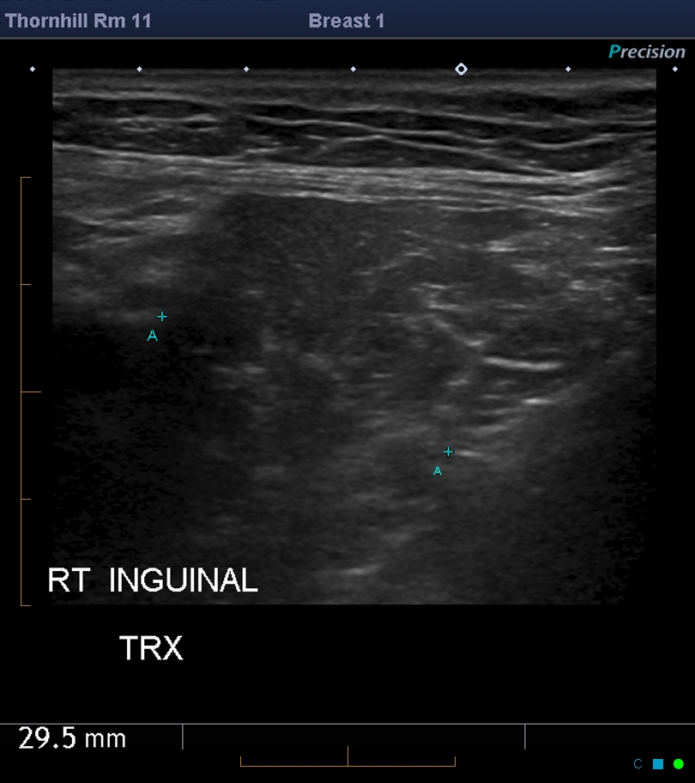
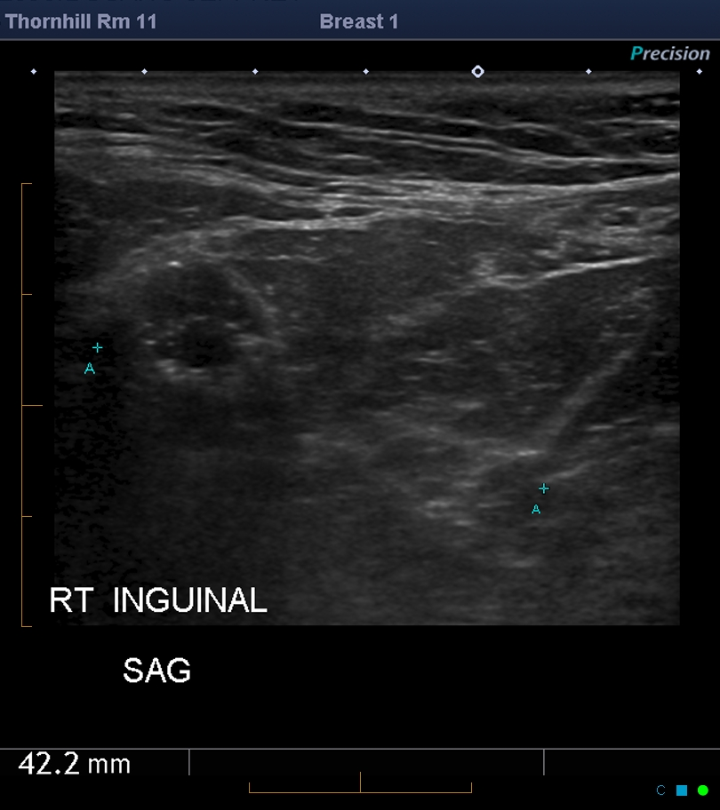

Slide 119
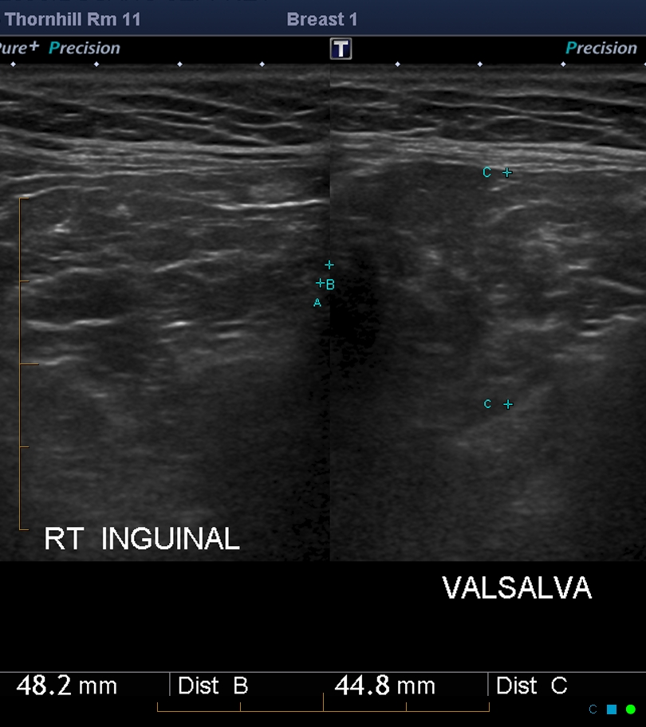

Slide 120
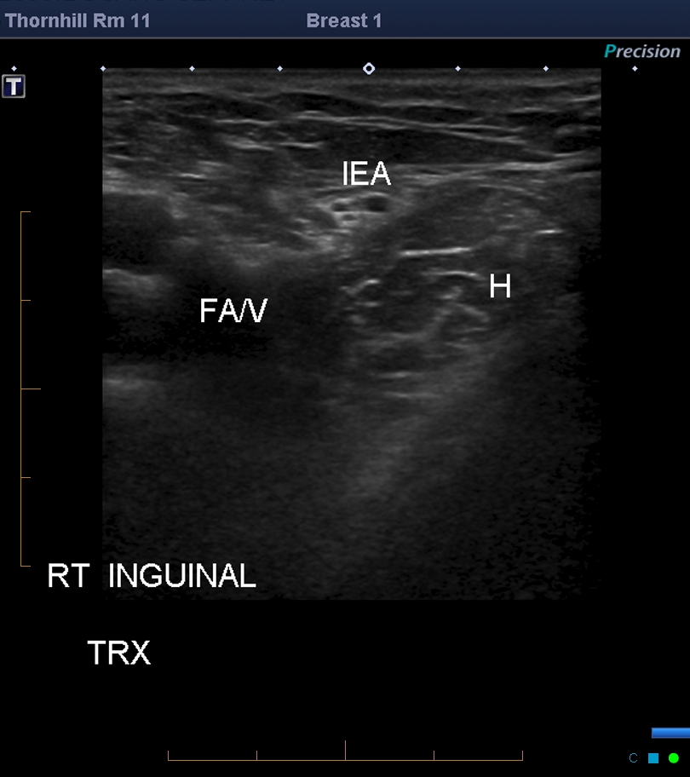

Slide 121
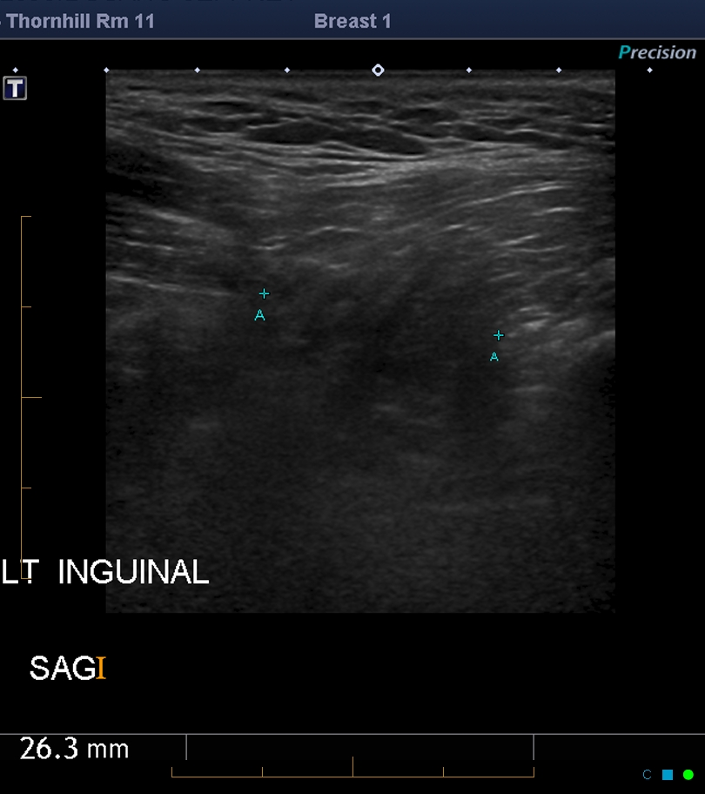

Slide 123
Hernias
Size of fascial defect
Size of hernia sac
Contents of sac:
Fat
Bowel
other

Slide 124
Hernias
Reducible with transducer probe pressure
Irreducible with transducer probe pressure
Obstructed/incarcerated : very narrow neck and bowel loop is trapped
Strangulated: compromise of the blood supply
Bowel peristalsis, bowel wall thickening, fluid in bowel loop, fluid in sac, hyperechoic fat, thickening of hernia sac, doppler flow of contents

Slide 126
Incarcerated abdominal hernia

Slide 127
Incarcerated abdominal wall hernia with dilated nonreducible small bowel loops and fluid in the hernia

Slide 128
Strangulated inguinal hernia with dilated bowel loop

Slide 129
Don’t forget
Repeat standing
Look for masses, lymphadenopathy, fluid collection, abscess or aneurysm

Slide 130
Diastasis Recti

Slide 131
Linea alba

Slide 132
Progressive weakening of Linea Alba

Slide 133
Static & Dynamic Image of Diastasis
Measure distance in between
Valsalva and remeasure

Slide 134
Diastasis

Slide 135
Diastasis

Slide 136
Diastasis

Slide 138
Bibliography
P. Yoong ^{et} al. The inguinal and femoral canals: a practical step-by-step approach to accurate sonographic assessment, Education exhibit poster, ECR 2014 / C-1243 .
Tomasso Vincenzo Bartolotta , Abdominal and Inguinal hernias, University of Palermo, June 19, 2014 Video

